Slide 1
DATA607 - COVID Data
Josh Iden and Jawaid Hakim
Notes:
Slideshow generated using Rmd + Pandoc + Powerpoint

Slide 2
Motivation
Use COVID-19 datasets to explore global pandemic stats
Explore relationships between COVID-19 prevalence and other datasets, e.g. mask policies, S&P500
Notes:
Global pandemic has been one of the most consequential events in recent memory. We wanted to acquire and explore COVID data together and other datasets like mask policies, S&P 500, etc.
Data acquisition journey was interesting and typical of data exploration projects: start with one dataset, end up with another. The key for us was to follow best practices and not be afraid to change strategy in light of better options.
Primary sources - JHU CSSE (Center for Systems Science and Engineering), Our World in Data (OWID)
Quick data journey…

Slide 3
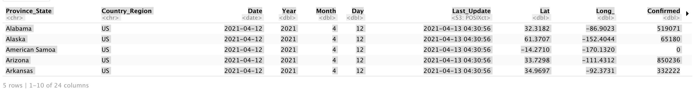
Data Acquisition - JHU CSSE USA Daily Data
US Daily
Notes:
2020-2022, one file per day (950+ files), one row per state/province

Slide 4
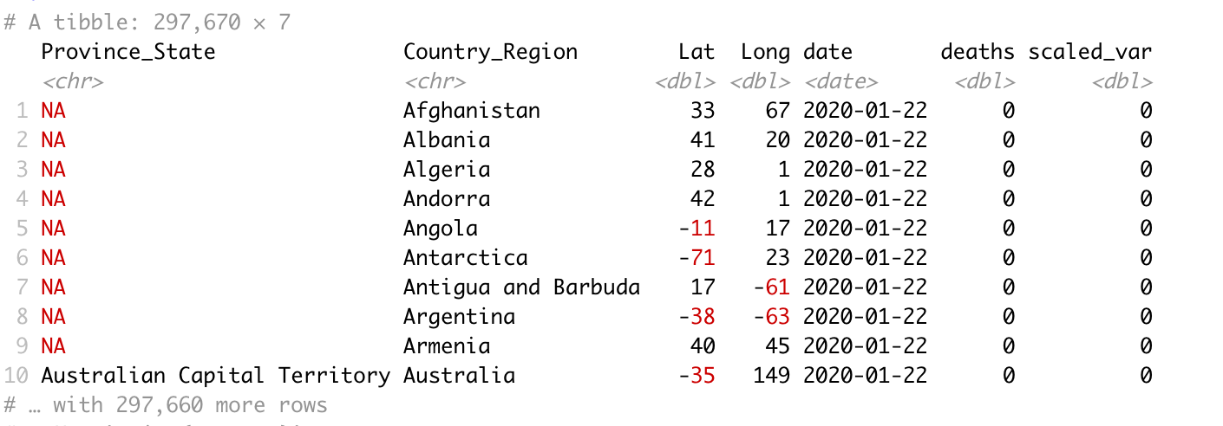
Data Acquisition - JHU CSSE Global timeseries
Global Timeseries
Notes:
Pivoted to Global timeseries data because we were interested in global impact of COVID.
2020-2022, one timeseries file, one row per country/state/province, 950+ variables per row (for each day in time period). Pivot long to get single country/state/province/day observation per row

Slide 5
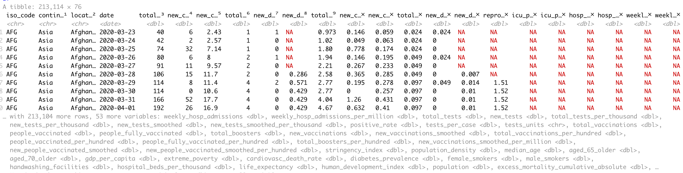
Data Acquisition - Our World In Data
OWID Comprehensive Timeseries
Notes:
Discovered Our World in Data COVID dataset (used JHU CSSE data plus other sources). This global COVID dataset contained many interesting variables (e.g. population percentage over 65 years old) that we thought would be useful for exploratory data analysis.

Slide 6
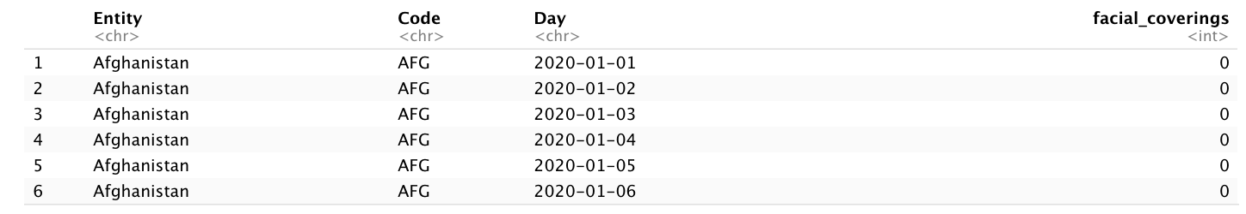
Data Acquisition - Face Coverings

Slide 7
Data Wrangling - Strategy
Common data extraction scripts/functions across datasets to maximixe code resuse
Tech Stack
Rselenium: headless browser for getting around embedded JavaScript
parallel: chosen for efficiently processing remote data files using a local cluster
readr: reading remote/local CSVs
Leaflet: interactive global map
Spark/sparklr: proof-of-concept Spark cluster. Cloud hosted Spark services are fee-based or time-limited - used local cluster
AWS S3: AWS S3 rate-limits made it impractical
Notes:
Rselenium – Selenium is used for automated testing of web applications but comes in handy for web scraping. Key concepts: Remote Web driver (Selenium Server, rsDriver for Chrome), headless browser processes both static HTML and JS, provides interaction with the DOM (via ID/Class/CSS-selector) and access to fully rendered web page content.

Slide 8
Data Wrangling - Challanges
Github API rate limits. Implemented OAuth authentication to access Github via a personal account for higher limits.
OWID dataset did not provide latitude/longitude variables. Downloaded a separate dataset with country lat/long and (left) joined with OWID for plotting on map

Slide 9
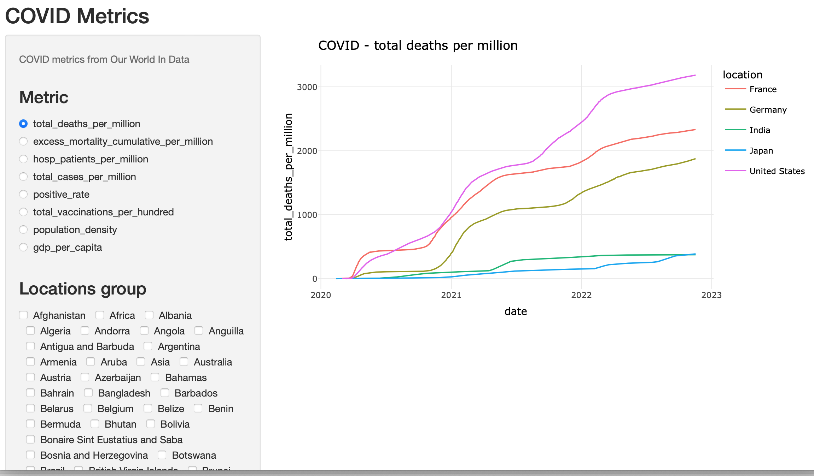
Interactive data exploration - Shiny
OWID Comprehensive Timeseries
Notes:
Interactive exploration: Shiny app deployed on shinyapps.io
1. Add Bolivia, add Barbados, remove Bolivia
2. positive_rate – add Bolivia

Slide 10
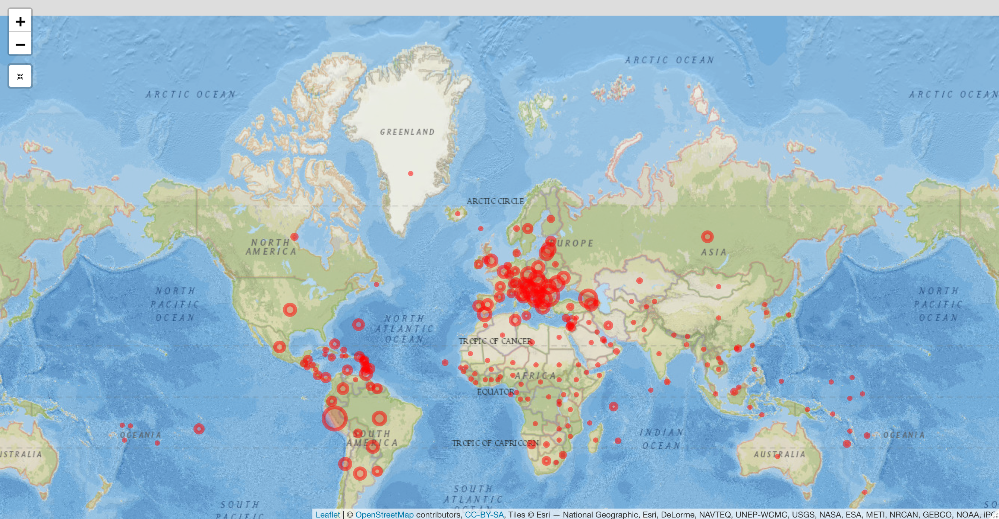
Interactive map visualization - Leaflet
OWID Comprehensive Timeseries
Notes:
Fully interactive map, easy to change skins, zoom down to city/street levels

Slide 11
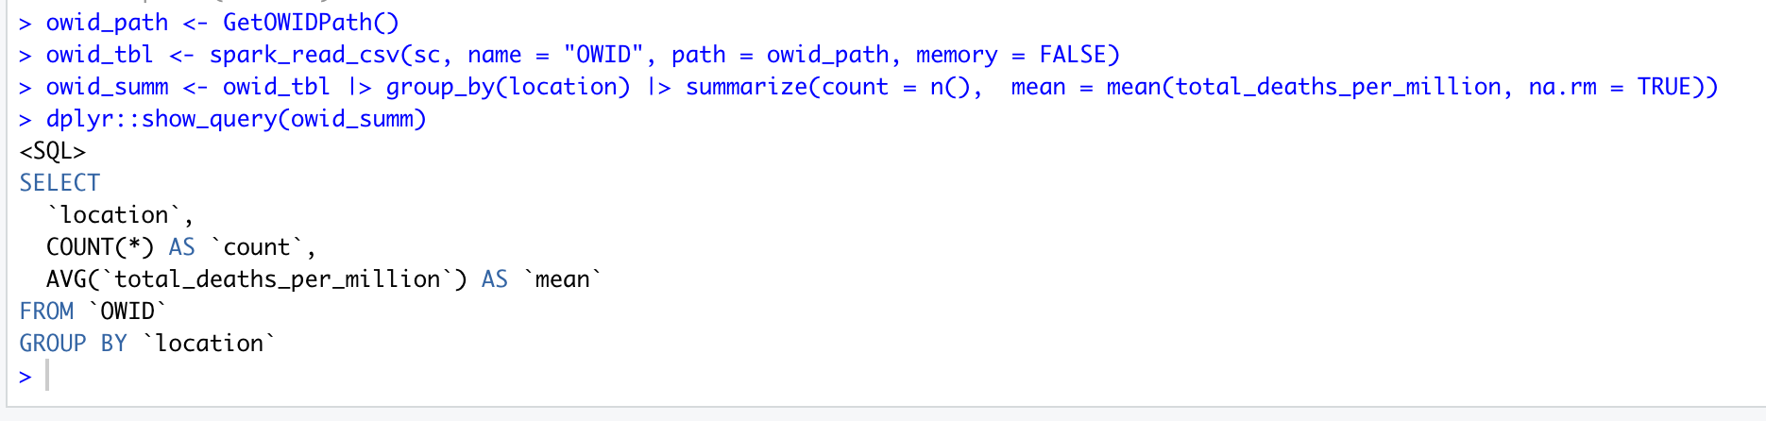
Spark Query
Notes:
Load large datasets into Spark cluster
Query/transform data without loading into R (avoid network roundtrip and memory issues)
Run scalable feature transformations (ft_) and machine learning (ml_) workloads on the Spark cluster
This example shows integration between Spark and dplyr – run dplyr pipelines as usual, SQL generated underneath to query Spark tables

Slide 12
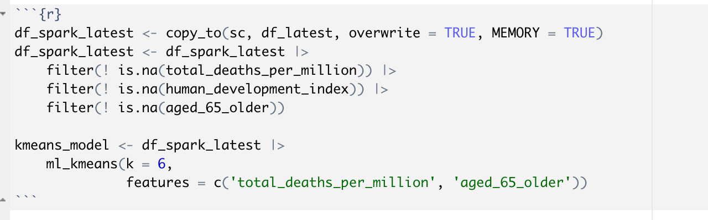
Spark ML - K-Means Clustering
Notes:
Spark ML – build ML models on the Spark cluster, no need to load data into R, just load fitted model into R, integrates with tidymodels!
K-means – create K (6) clusters using selected data set features

Slide 13
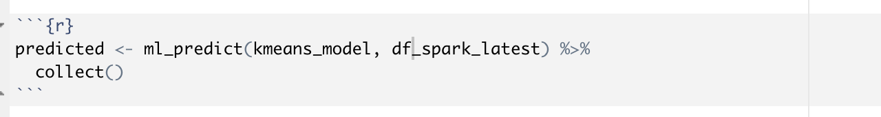
Spark ML - K-means predictions
Notes:
Make predictions from fitted ML model

Slide 14
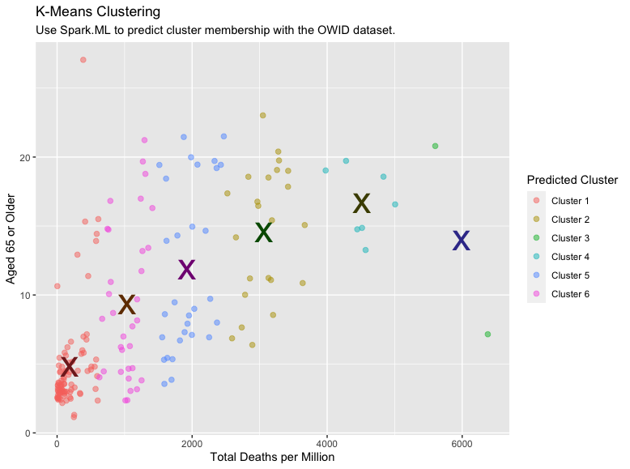
Spark ML - Plot K-means predictions
Notes:
Plot predictions using plain old R

Slide 15
Exploratory Data Analysis

Slide 16
Face Covering Dataset
Source: https://ourworldindata.org/covid-face-coverings
Countries are grouped into five categories:
0 = No policy 1 = Recommended 2 = Required in some specified shared/public spaces outside the home with other people present, or some situations when social distancing not possible 3 = Required in all shared/public spaces outside the home with other people present or all situations when social distancing not possible 4 = Required outside the home at all times regardless of location or presence of other people

Slide 17
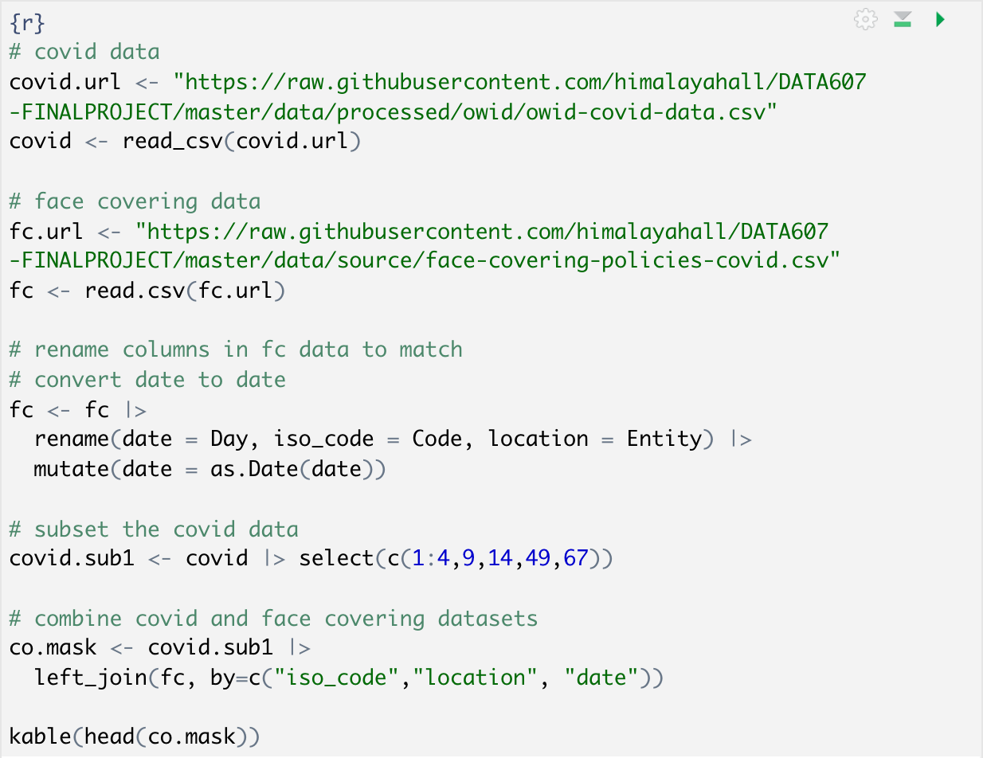
Combining the Covid and Mask Policy datasets

Slide 18
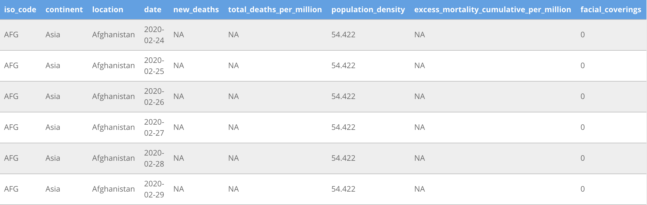
Combining the Covid and Mask Policy datasets (cont’d)

Slide 19
Face Covering Dataset (cont’d)
Aggregate - does not account for intra-country dynamics
Mask policy is typically in response to Covid outbreaks

Slide 20
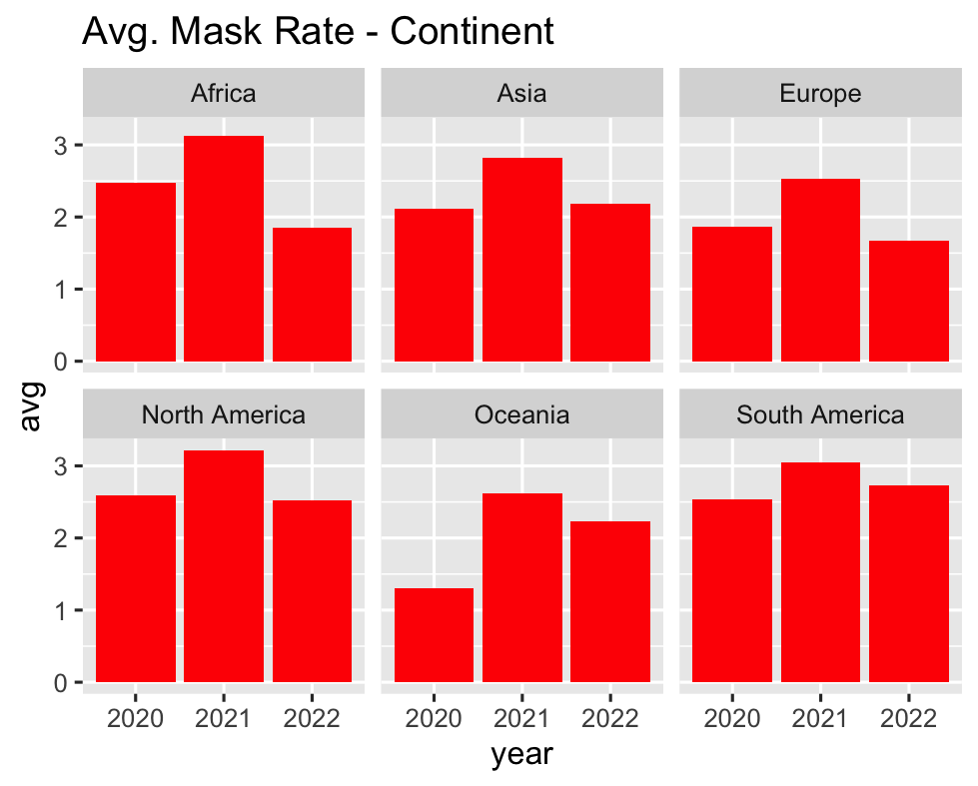
Avg. Mask Rates - Continent

Slide 21
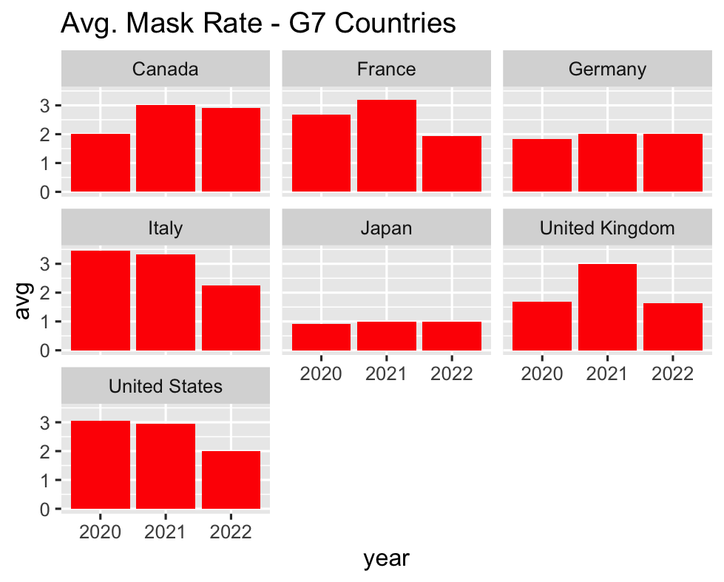
Avg. Mask Rates - G7

Slide 22
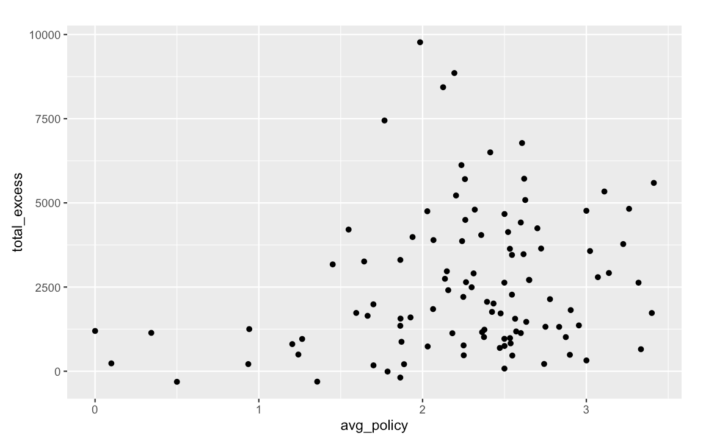
Excess Deaths by Avg. Mask Policy

Slide 23
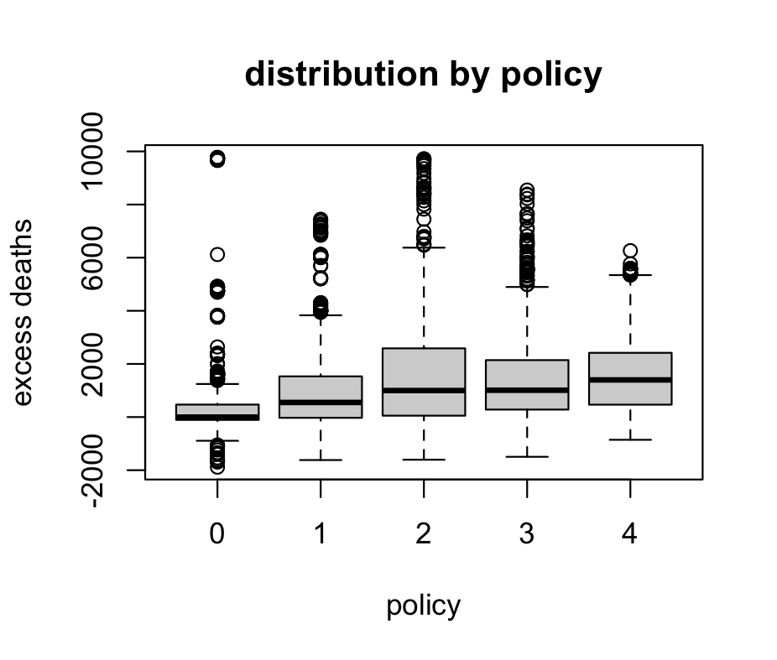
Excess Deaths by Mask Policy

Slide 24
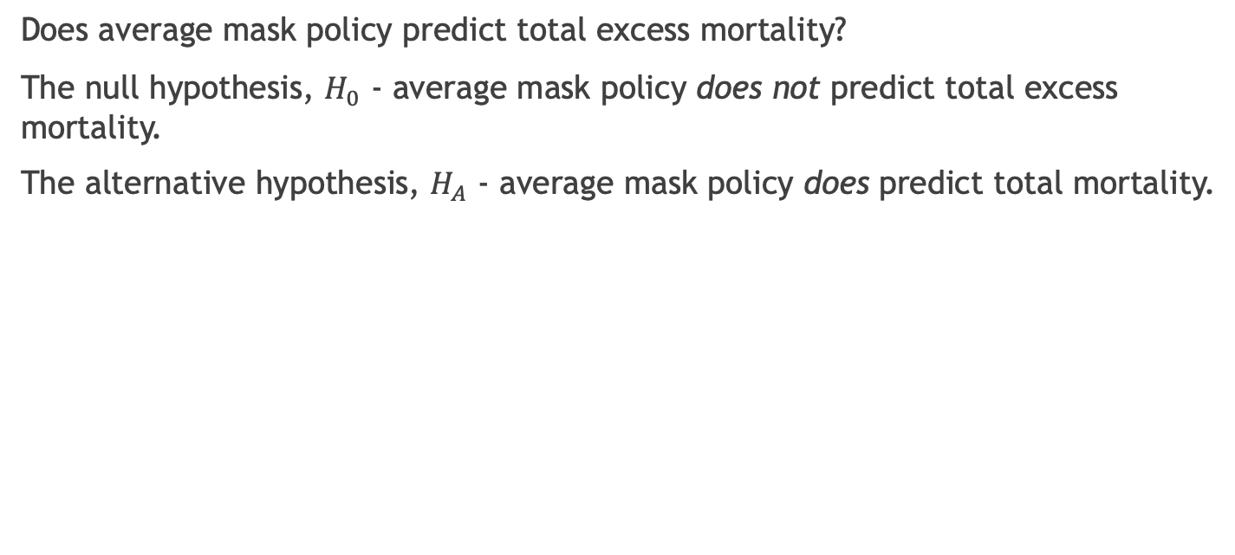
Statistical Analysis
Does average mask policy predict total excess mortality?
The null hypothesis, $H_{0}$ - average mask policy does not predict total excess mortality.
The alternative hypothesis, $H_{A}$ - average mask policy does predict total mortality.

Slide 25
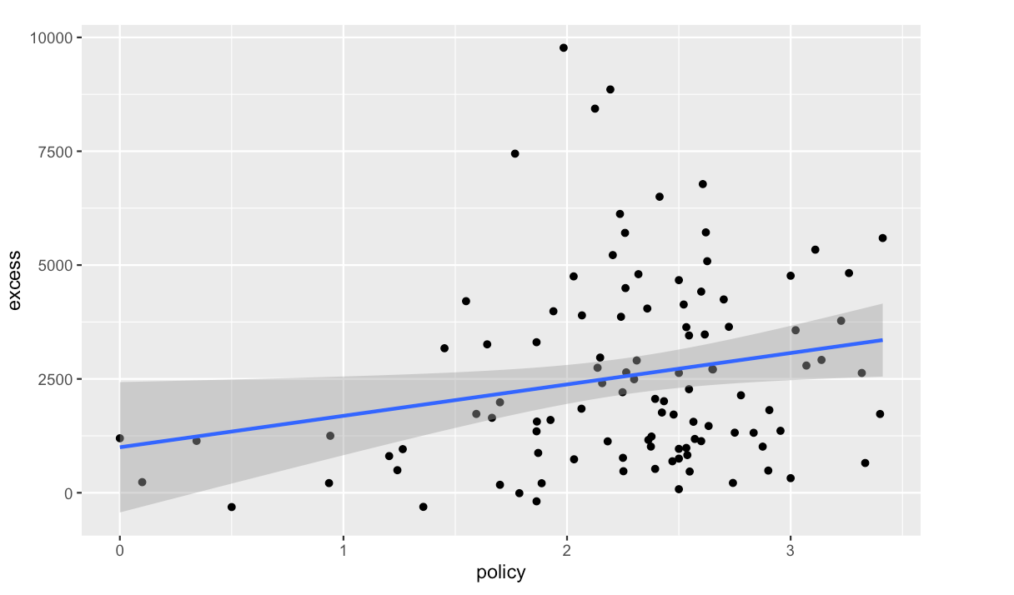
Relationship Between Mask Policy and Excess Death

Slide 26
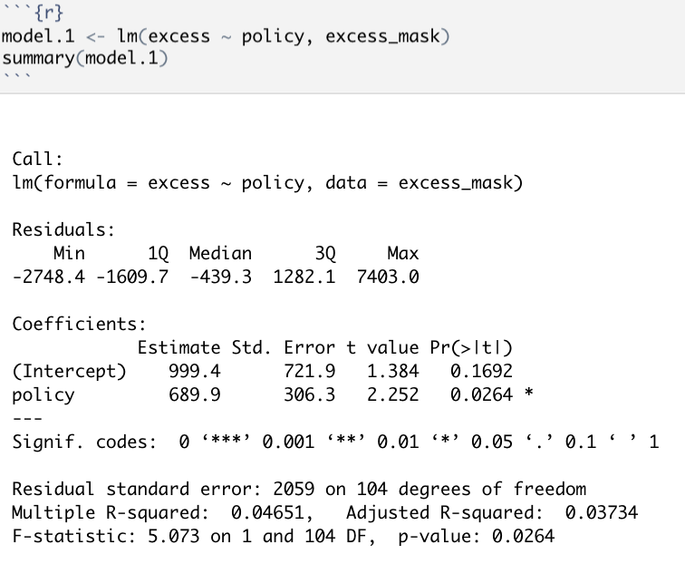
Fitting in a Linear Model

Slide 27
Interpreting the Model
p-value = 0.0264, significance
Multiple R-squared = 0.046, accounts for very little variance

Slide 28
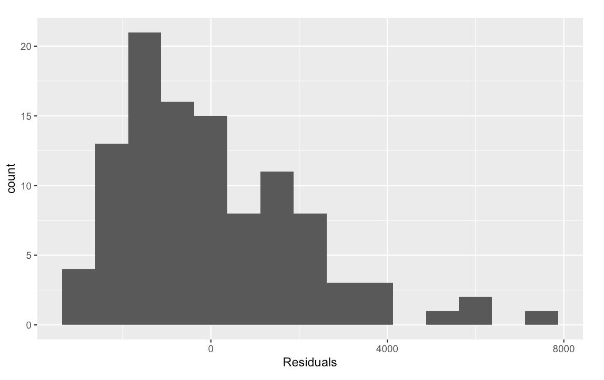
Residuals

Slide 29
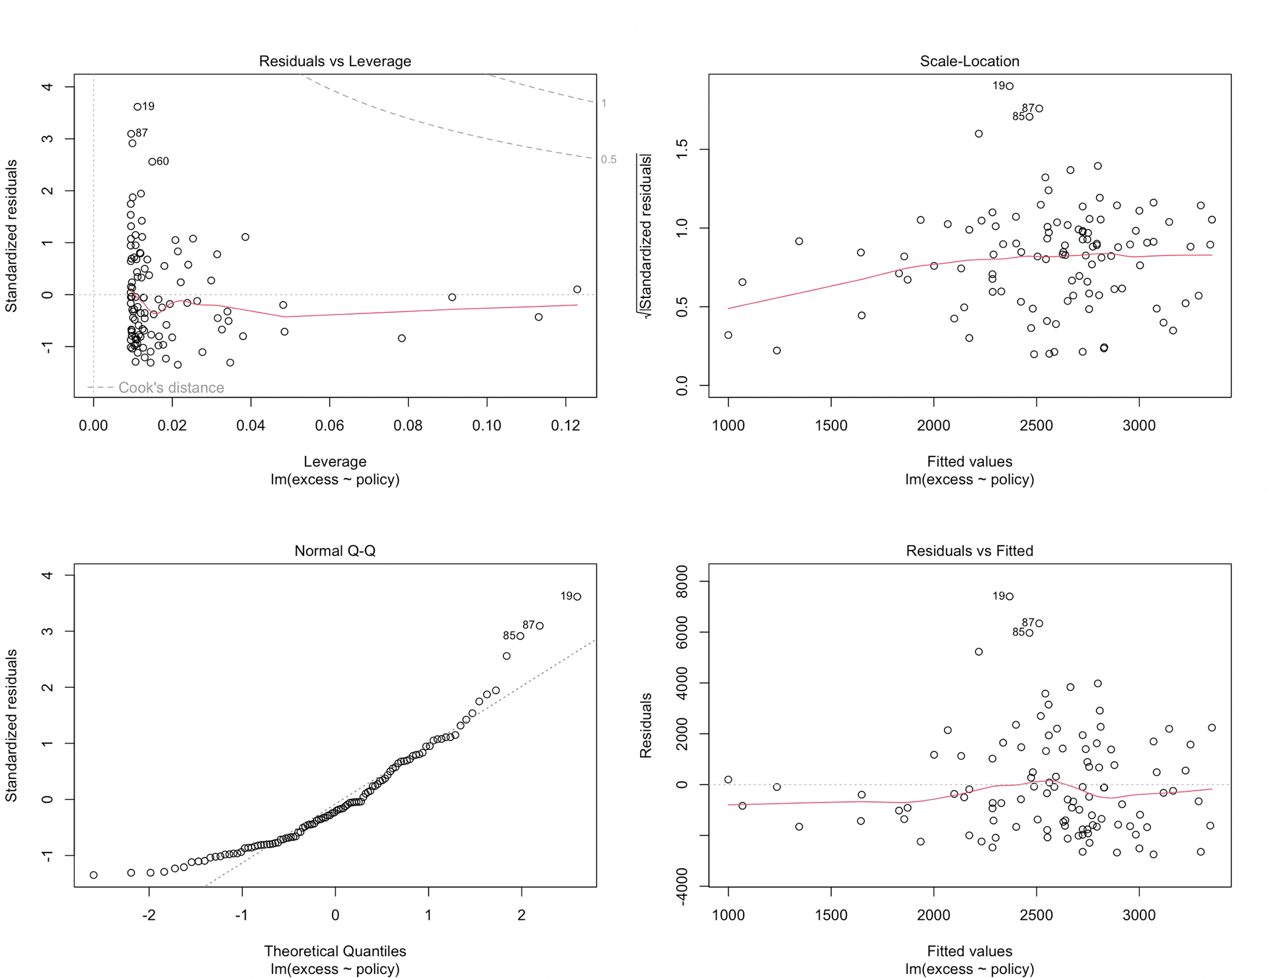
Residuals (cont’d)

Slide 30
Residuals (cont’d)
Linear
Non-Normal Distribution
Does Not Satisfy Homostedacticity (Non-Similar Variances)

Slide 31
Conclusion
Relationship exists
Not meaningful enough to predict
Possible reasons

Slide 32
Thank You!

